Slide 1


The Smarter Way to Park
Ben Poon, Sifat Bhuiyan, Ariella Katz, Drew Traldi

Slide 2
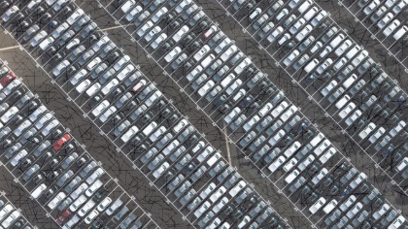
The Current State of Parking is…
Inefficient
Unpredictable
Unoptimized

Slide 3
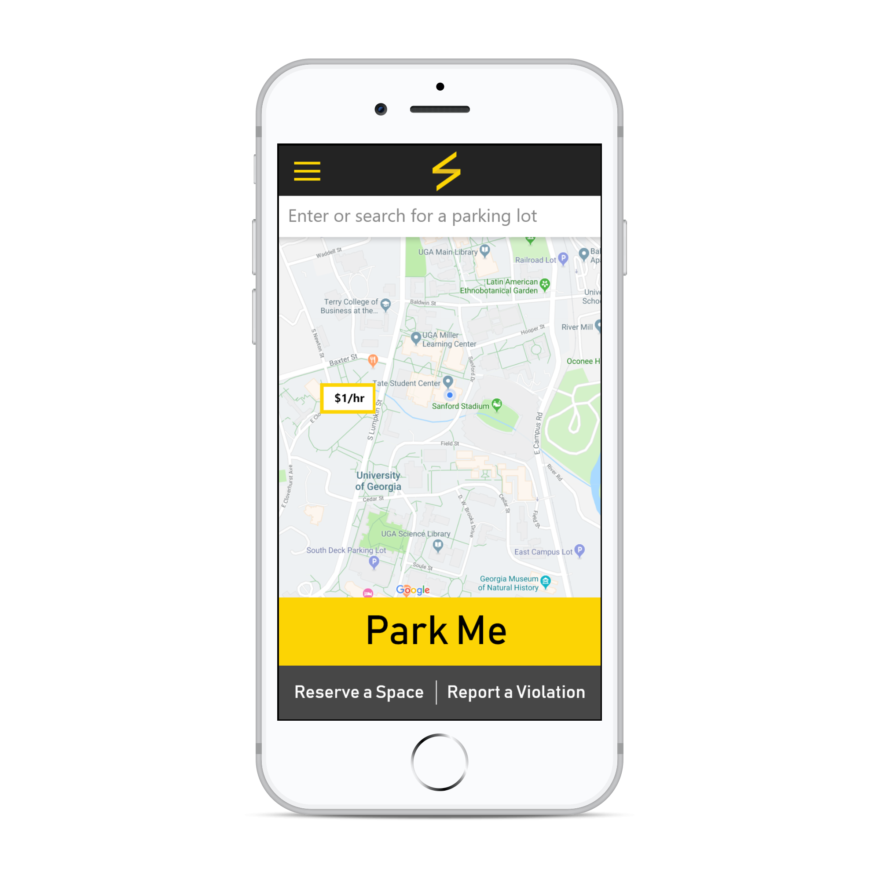
The Intelligent Cloud-Based Parking Management System
RSVP
eservable
mart
iable
ractical

Slide 4
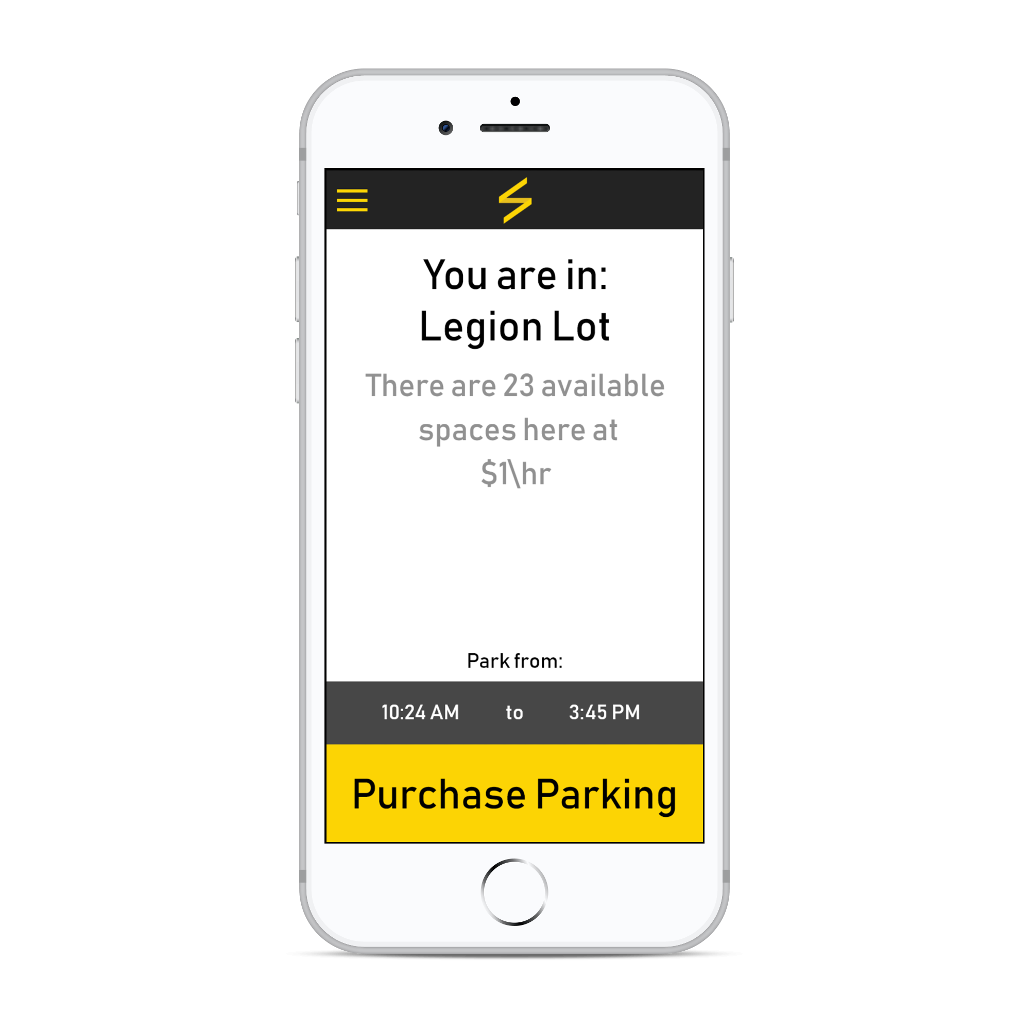
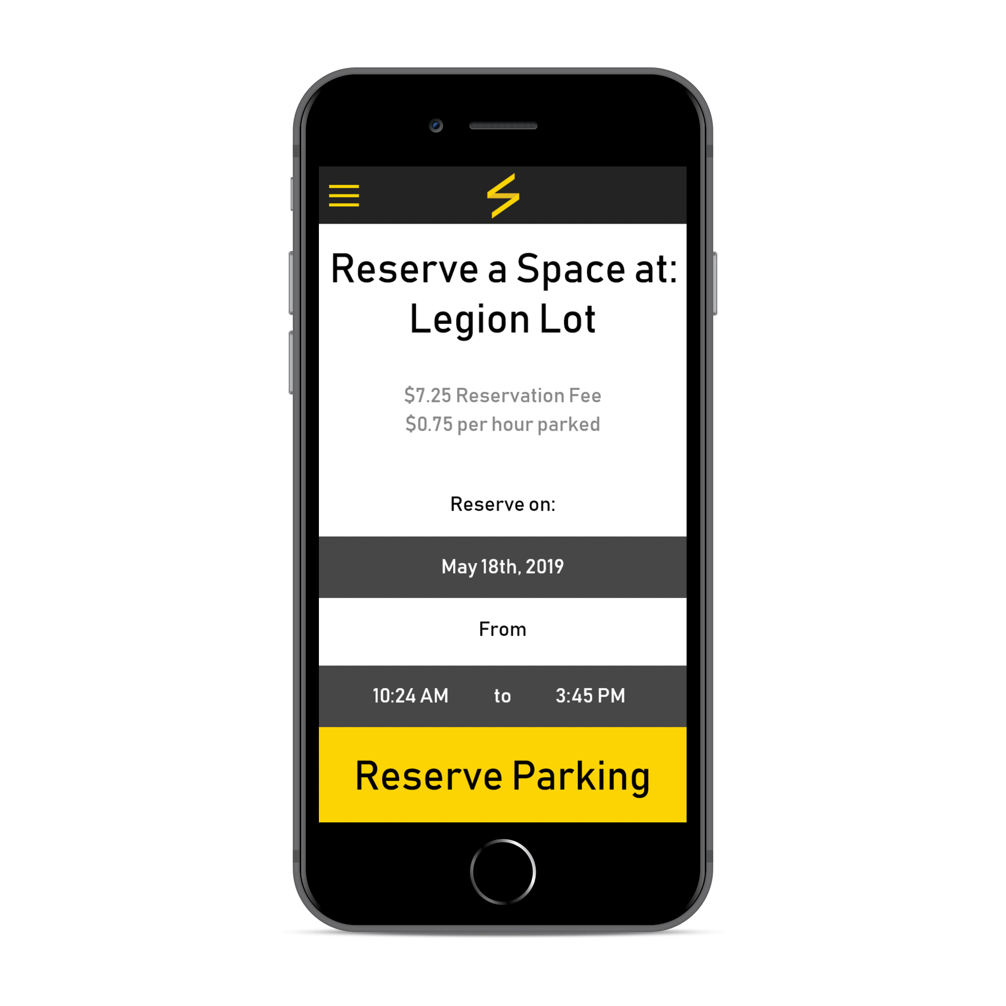

Slide 5
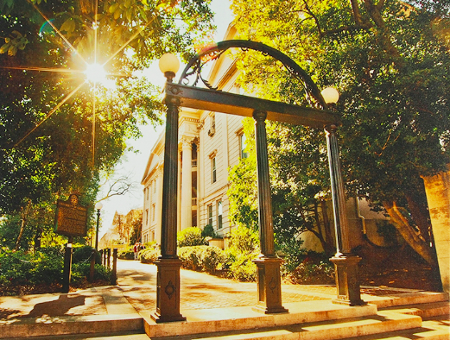



UNIVERSITY
Saves Money
Expands Target Market
Sustainable
Increased Student Satisfaction
&
STUDENTS
New Parking Options
Increased Affordability
Spot Assurance

Slide 6
Implementation Roadmap
Communicate With Parking Services
Partner With Comp Sci Dept.
Pilot
Expand to Decks
Expand Campus-Wide

Slide 7
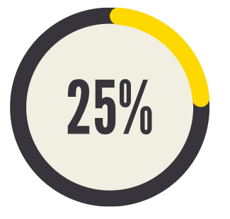

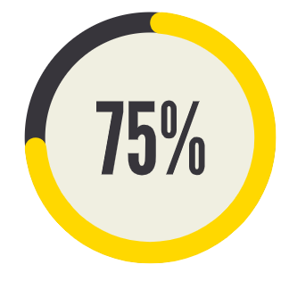

Financial Metrics: Based on 50/50 Model
$4,950
$9,900
$14,850
$19,800
Revenue per Month

Slide 8
Q
uestions?

